Slide 1
Speaker Knowledge Influences the Comprehension of Pragmatic Inferences
Replication of Bergen & Grodner 2012
Disha Dasgupta

Slide 2
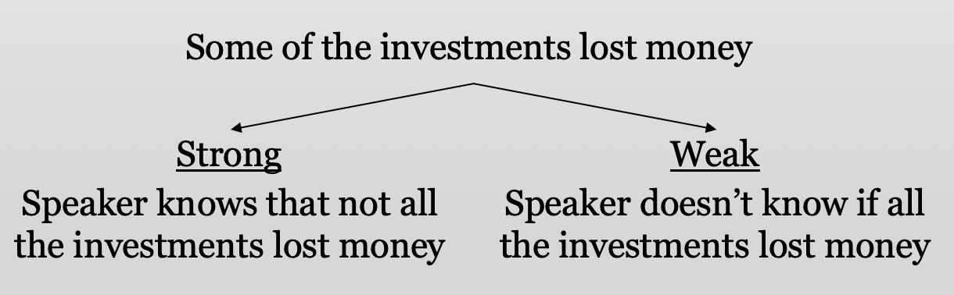
Introduction
Scalar Implicature: an implicit inference beyond the literal meaning of a sentence

Slide 3
Objective
To investigate how, and at what point in interpretation, speaker knowledge affects the comprehension of scalar implicatures

Slide 4
Hypothesis
If perceivers incorporate speaker knowledge during online comprehension, then they will generate a strong implicature in the full-knowledge context but a weak implicature in the partial-knowledge context.

Slide 5
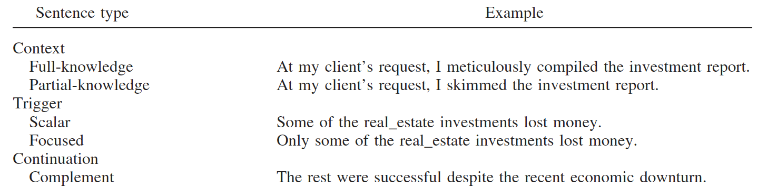
Stimuli
quantifier
spillover
focus
anaphor
predicate

Slide 6
Context
Increased reading times over scalar quantifier in trigger sentences in full knowledge context
Integrating/processing extra information
Decreased reading times over the complement sentence in full knowledge context
Strong implicature evokes the complement set during the trigger sentence, while the weak implicature does not
Trigger sentences with focus particle
Asserts not all condition in a literal manner
Trigger/complement sentence processing unaffected by speaker knowledge

Slide 7
Procedure
52 participants (versus original 42)
24 stimulus passages consisting of context, trigger, and continuation sentences
6 possible conditions
Cross full/partial knowledge contexts and scalar/focused triggers (4)
Duplicate scalar trigger conditions with cancelation instead of complement sentences (2)
Self-paced reading paradigm - measured reading times (RTs) per word for each stimulus passage (in ms)
Follow-up comprehension questions

Slide 8
Analyses
Comparison of mean RTs
Untransformed RTs
Linear mixed-effect regression analysis
Predict (log-transformed) RTs from speaker knowledge and trigger type
Fixed Effects: Speaker Knowledge, Trigger
Random Effects: Participants, Stimulus Items

Slide 9
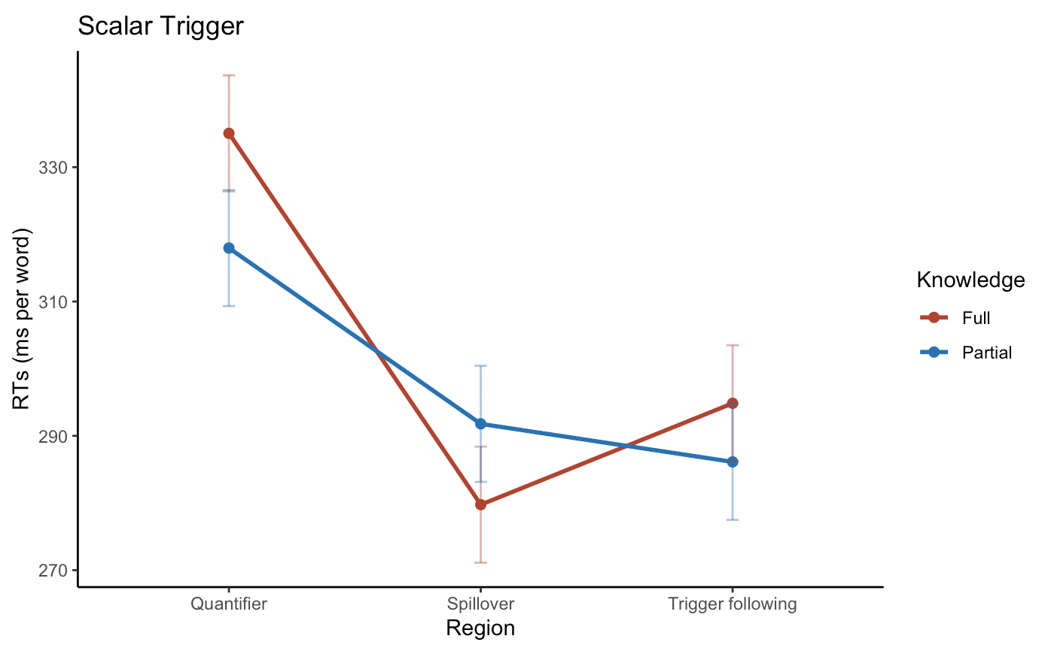
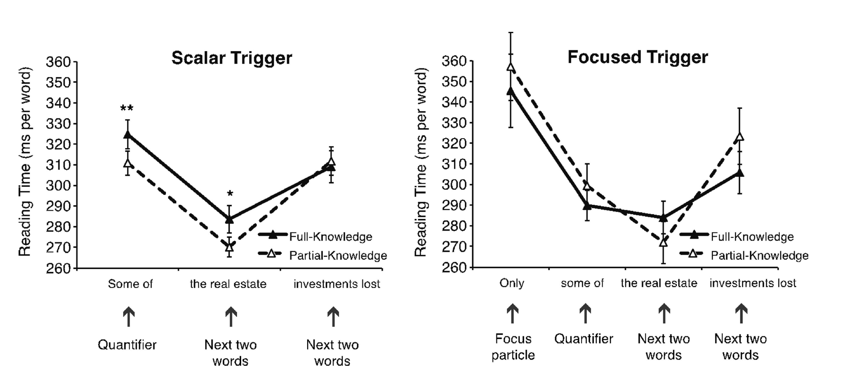
Comparison of Reading Times Trigger Sentences

Slide 10
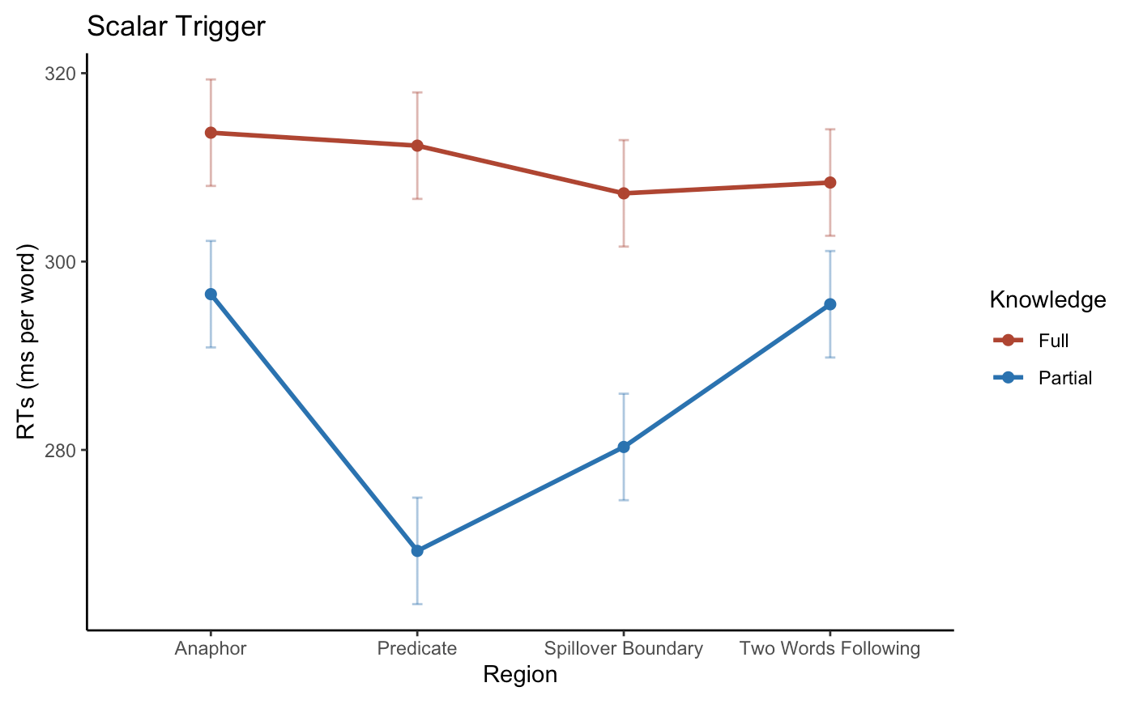
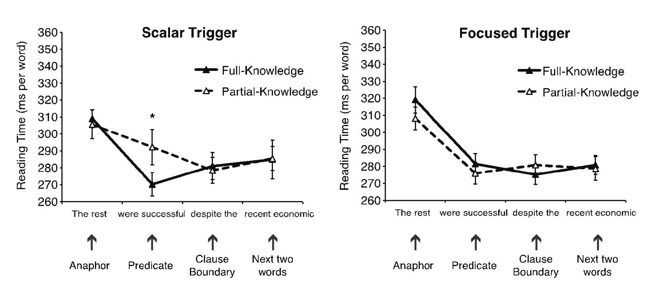
Comparison of Reading Times Complement Sentences

Slide 11
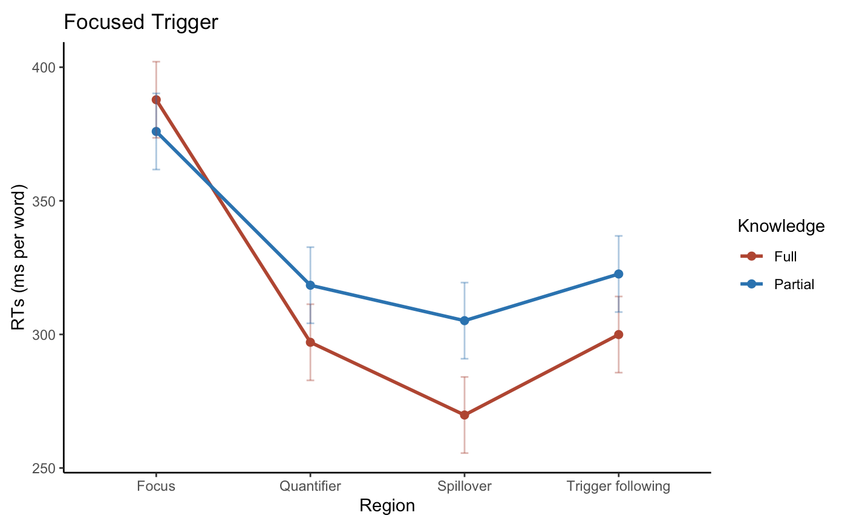
Comparison of Reading Times Trigger Sentences

Slide 12
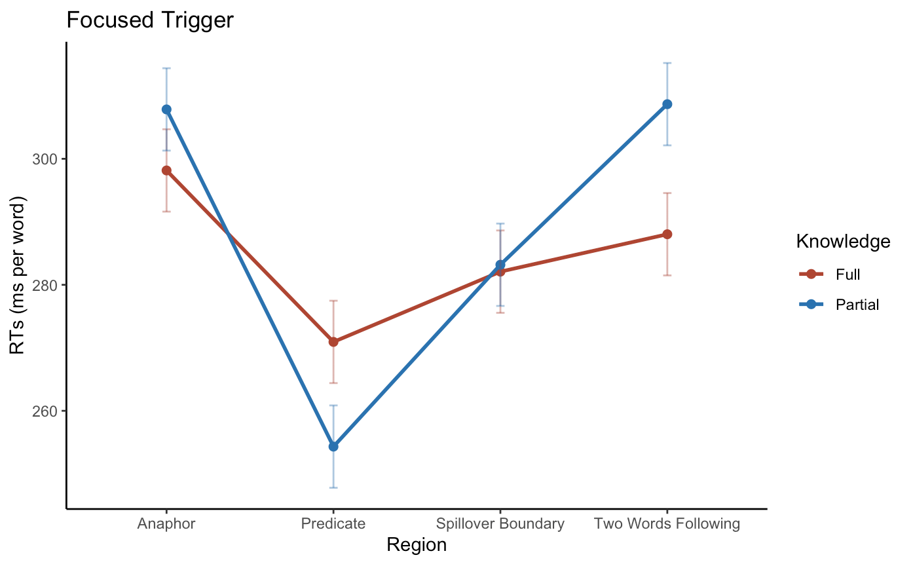
Comparison of Reading Times Complement Sentences

Slide 13
Regression Model Trigger Sentences
Quantifier
Spillover
 | Coefficient | t-value | p-value
Knowledge | -- | 1.03 | --
Knowledge | .008 | .418 | .676
Trigger | .035 | 4.98 | .0001***
Trigger | .054 | 2.808 | .005**
Interaction | .016 | 2.37 | .0164*
Interaction | -.042 | -1.081 | .280
 | Coefficient | t-value | p-value
Knowledge | .015 | 2.49 | < .05*
Knowledge | .069 | 3.126 | .003**
Trigger | -- | -- | --
Trigger | .004 | .168 | 0.868
Interaction | -- | -- | --
Interaction | -.048 | -1.241 | .218

Slide 14
Regression Model Complement Sentences
Anaphor
Predicate
 | Coefficient | t-value | p-value
Knowledge | -- | -- | --
Knowledge | -.049 | -1.603 | .109
Trigger | -- | -- | --
Trigger | -.041 | -1.329 | .184
Interaction | -- | -- | --
Interaction | -.085 | -1.379 | .168
 | Coefficient | t-value | p-value
Knowledge | -- | -- | --
Knowledge | -.058 | -1.310 | .205
Trigger | -- | -- | --
Trigger | -.047 | -1.304 | .196
Interaction | .018 | 2.09 | < .05*
Interaction | -.109 | -1.560 | .122

Slide 15
Discussion
“In the trigger sentence, full-knowledge caused greater processing difficulty at the scalar quantifier”
Full/Partial Knowledge RTs over Scalar Quantifier: 335 ms vs 318 ms
Effect At Quantifier: Less processing difficulty in full-knowledge condition⁺
“In the complement sentence, full-knowledge facilitated processing when referring back to the complement set evoked by the strong implicature”
Higher complement sentence RTs in full knowledge condition
Effect at Anaphor/Predicate: Greater processing difficulty in full-knowledge condition⁺
Focus condition - trigger/complement sentence processing unaffected by speaker knowledge
No significant difference in RTs for trigger sentence quantifier region and complement sentence anaphor region
⁺Not significant

Slide 16
Conclusion
General findings were reproduced
Despite deviations from original study (specifically in complement sentence processing)
Speaker knowledge affected the likelihood of generating the strong implicature

Slide 17
Questions?

